Slide 1

Kary Well Capstone Project Presentation 卒業論文プレゼンテーション

Slide 2
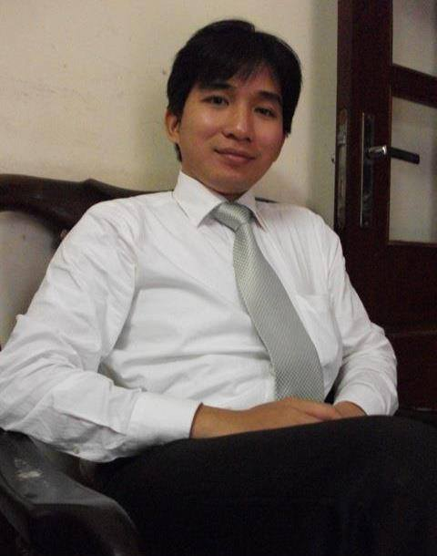



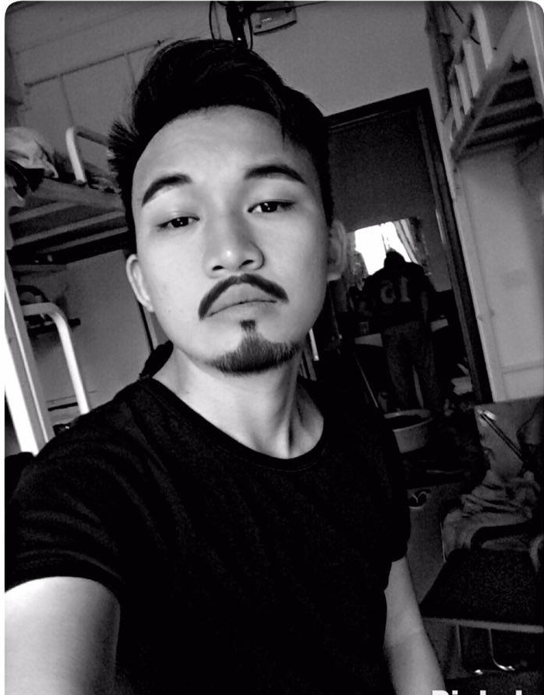
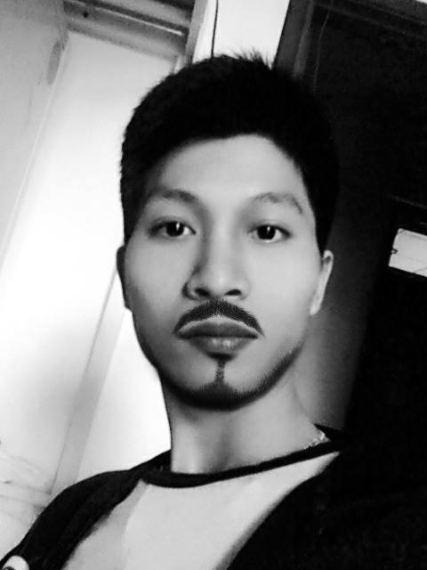

About Us
Supervisor 指導教員 Team member チームメンバー | Lecturer TRAN BINH DUONG LE VAN QUY HOANG – SE90184 TRAN DINH HOANG HUY – SE90201 NGUYEN KHAC HOANG – SE02564 NGUYEN VAN QUYEN - SE02884 KIEU CAO KHANH – SE02960 NGUYEN THI HONG NHUNG – SE02437
HoangLVQ
HuyTDH
HoangNK
QuyenNV
KhanhKC
NhungNTH

Slide 3
Outlines -アウトライン
Introduction
導入
II. Project Management
プロジェクト管理
III. Software Requirement Specification
プロジェクト管理
IV. Software Design Description
ソフトウェア要求仕様
V. Quality Control
品質管理
VI. Project Result
プロジェクト結果
VII. Demo
デモ
VIII. Q & A
質問と回答

Slide 4
1. Introduce (導入)
Background
Literature review
Proposal

Slide 5
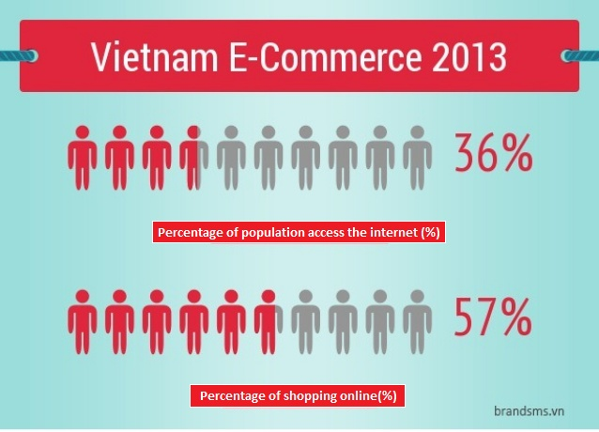
Background
According to the statistics of Vietnam E-Commerce and Information Technology Agency, in 2013 the population of Viet Nam is up to 90 million, in which 36%(31,3 million people) Internet access and more than half of this (57%) is shopping online

Slide 6

Background
In Vietnam the legal procedures to become a delivery services enterprise very simple
At the point “a” of Clause 1 of Article 20 in this Decree: “To request consignors to permit the examination of contents of information in the form of document (excluding mails), merchandise packages or packs to be delivered”

Slide 7
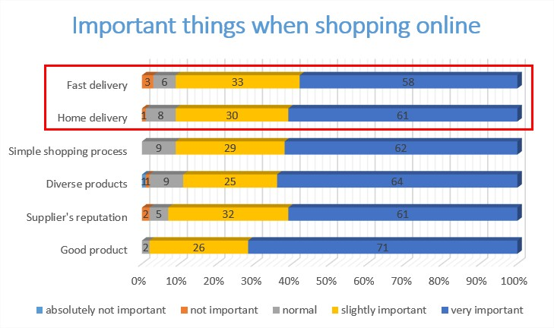
Background
61% of people said that home delivery is very important when shopping online.
58% said that fast delivery is very important.

Slide 8
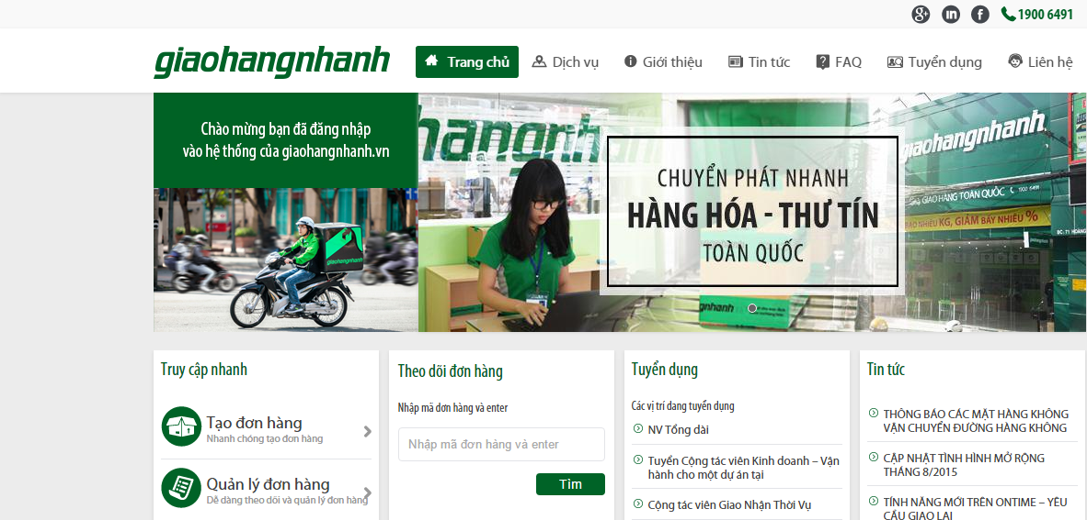
Literature review
Giaohangnhanh.vn
Pros:
Well know brand image in Vietnam
Having many shippers, system can receive lots of orders
Low price
Cons:
Track order function is not well interface, just use text to display status (Wait, Shipper is comming, Shipping, Done)
Don’t have express delivery service.
Don’t have mobile app for shipper to find the way.

Slide 9
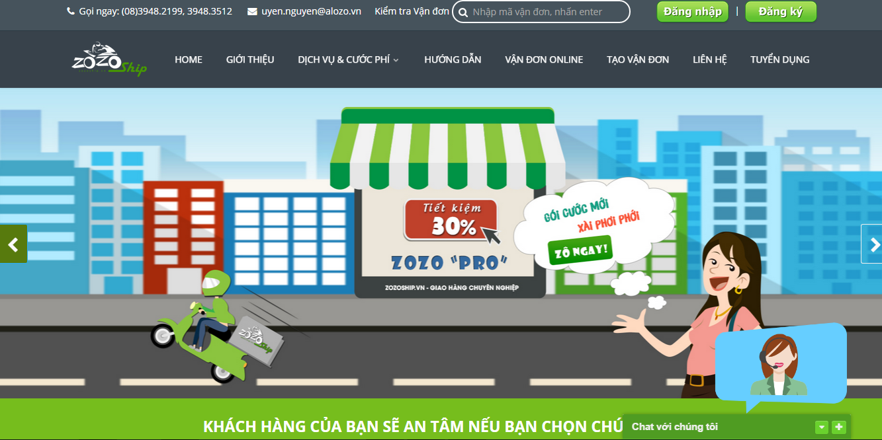
Literature review
Zozoship.vn
Pros:
Track order status on website
Many service pack with clearly information
Nationwide delivery
Goods insurance
Cons:
Working are: only Ho Chi Minh city
Don’t apply technology to immediately find the nearest shipper to the order.
Track order function is not well interface, just use text to display status

Slide 10
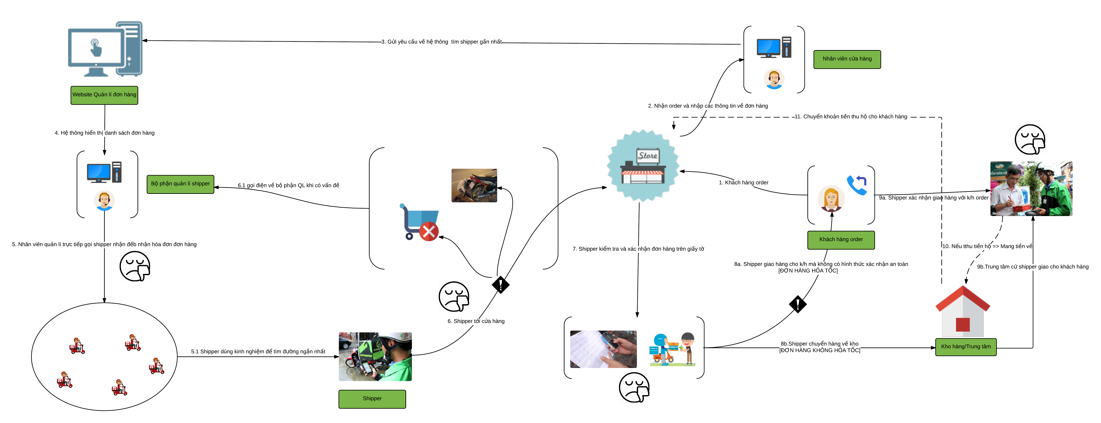
Rich picture
Zozoship.vn

Slide 11
Proposal
We’ll develop a system that include 4 part:
Part 1: Web application for store that support store’s employee everything they need to create an order, verify shipper who come to takes goods. Store also knows location of shipper (goods) on maps.
Part 2: Mobile-application for shipper that support shipper view information of order,. Beside, shipper can notify to system if have issue while delivering.
Part 3: Web application for admin that help system managers manage shipper, store, transaction history and know about issue of delivery process.
Part 4: Web service that save all information of store, shipper and transaction history.

Slide 12
Literature review
 | Giaohangnhanh.vn | ZOZO SHIP | Shipper Team | KW
Working on Hanoi |  |  |  | 
Auto find the shipper nearest to the order |  |  |  | 
Shippers can find the shortest way base on maps |  |  |  | 
Express delivery |  |  |  | 
Allow the stores to track transportation process |  |  |  | 
Cash on delivery service |  |  |  | 
Have statistic for stores |  |  |  | 
Method confirm shippers | Paper bill | Paper bill | Payer bill | Code/ Shipper information
Method confirm shippers deliver to right customers | Phone call/ Paper bill | Phone call/ Paper bill | Phone call/ Paper bill | Code

Slide 13
2. Project Mangement (プロジェクト管理)
2.1. Software Process Model
ソフトウェ アプロセス モデル
2.2.Project Organization
プロジェクト組織
2.3. Project Schedule
プロジェクト計画
2.4. Objectives & deliverables
目標 と 成果物
2.5. Tools & Infrastructure
ツールと インフラストラクチャ
2.6. Risks management
リスク管理
2.7. Configuration management
コンフィグレーション管理
2.8. Communication management
コミュニケーション管理

Slide 14
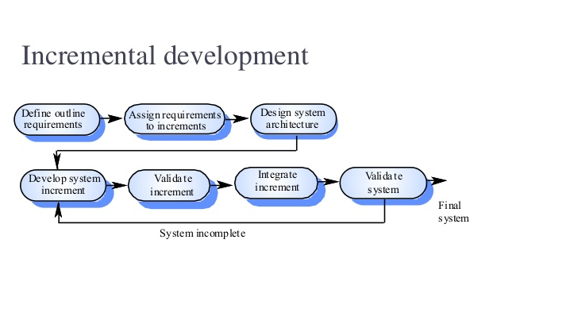
2.1 Software Process Model - ソフトウェアプロセスモデル
Some main functions can be developed early & quickly
More flexible - Easy & less costly to change if having.
Testing and debugging during smaller iteration is easy
Iterations may be run simultaneously. A design team starts the next iteration while the current one is under test
The project team learns from first iterations and may use best practices and experiences in next iterations
Easier to manage risk because risky pieces are identified and handled during its iteration.

Slide 15
2.2 Project Organization - プロジェクト組織
Tran Binh Duong
Supervisor
Le Van Quy Hoang
PM
Nguyen Khac Hoang
Technical Leader
Nguyen Thi Hong Nhung
Test Leader/QA
Tran Dinh Hoang Huy
Developer
Nguyen Van Quyen
Developer
Kieu Cao Khanh
Developer
Le Van Quy Hoang
Developer

Slide 16
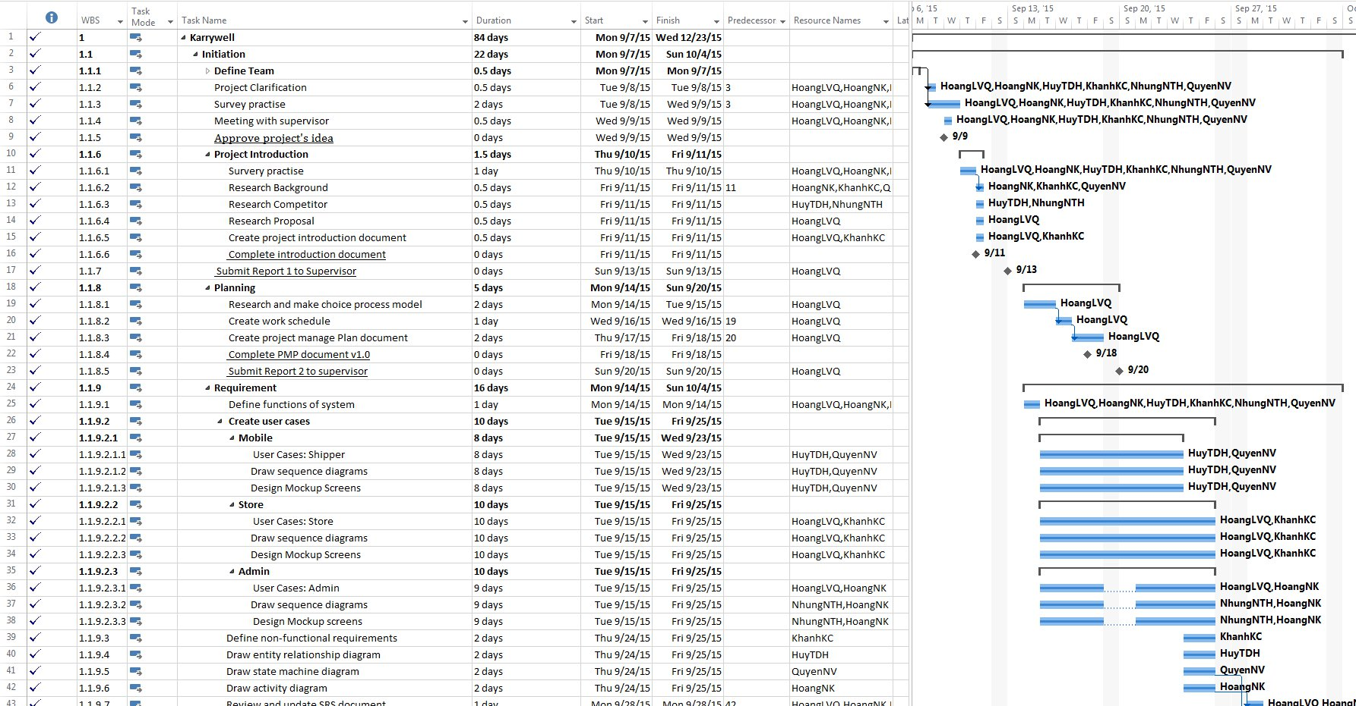
2.3 Project Schedule - プロジェクト計画

Slide 17
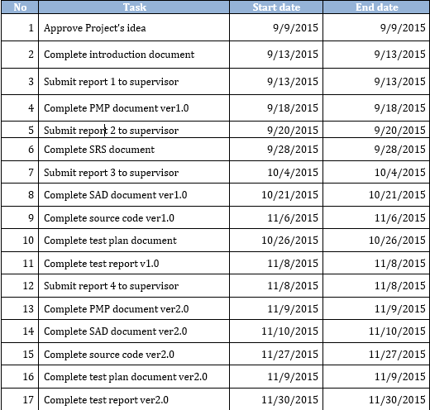
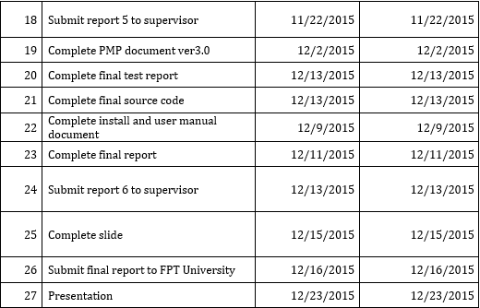
2.4 Milestones & deliverables - マイルストーンズと成果物

Slide 18
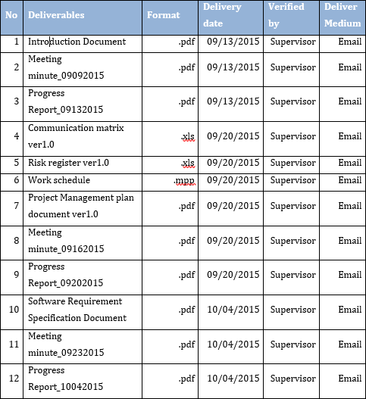
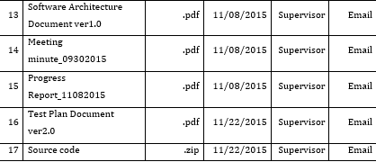
2.4 Milestones & deliverables - マイルストーンズと成果物

Slide 19










2.5 Tools & Infrastructure - ツールと インフラストラクチャ
Tools
Tools for project management
SourceTree
Word 2013
Excel 2013
Project 2013
Power Point 2013
Tools for developing
WebStorm
pgAdmin
Google Chrome
Firefox
Astah

Slide 20
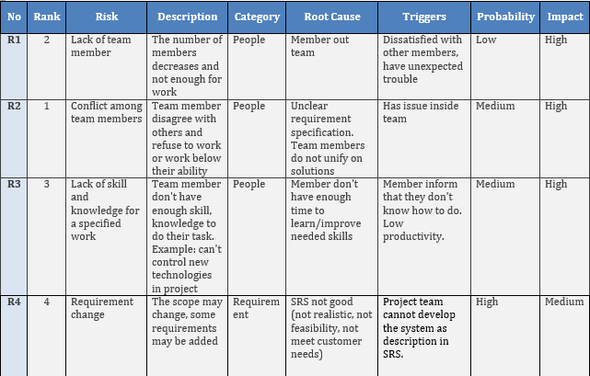
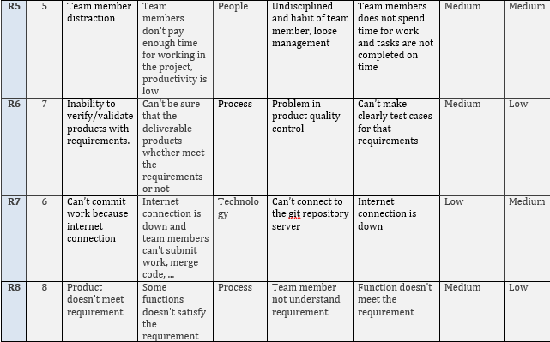
2.6. Risks management -リスク管理

Slide 21
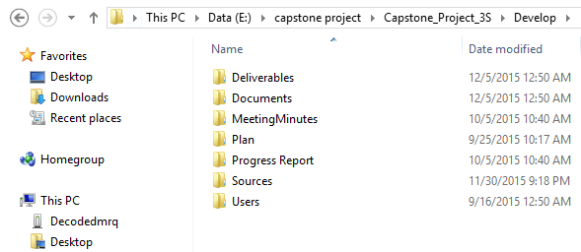
2.7 Configuration management - コンフィグレーション管理
Deliverables: Store deliverable document
Documents: Store documents of project
MeetingMinutes: Store meeting minutes of project
Plan: Store plan of project
Progress Report: Store report of project
Sources: Store source code of project
Users: Store any file of each member in project
Folder structure of project

Slide 22
3. Software Requirement (Specification -プロジェクト管理)
3.1. Business Process -ビジネスプロセ
3.2 Functional Requirements - 機能要求
3.3 Non-functional Requirements - 非機能要求

Slide 23
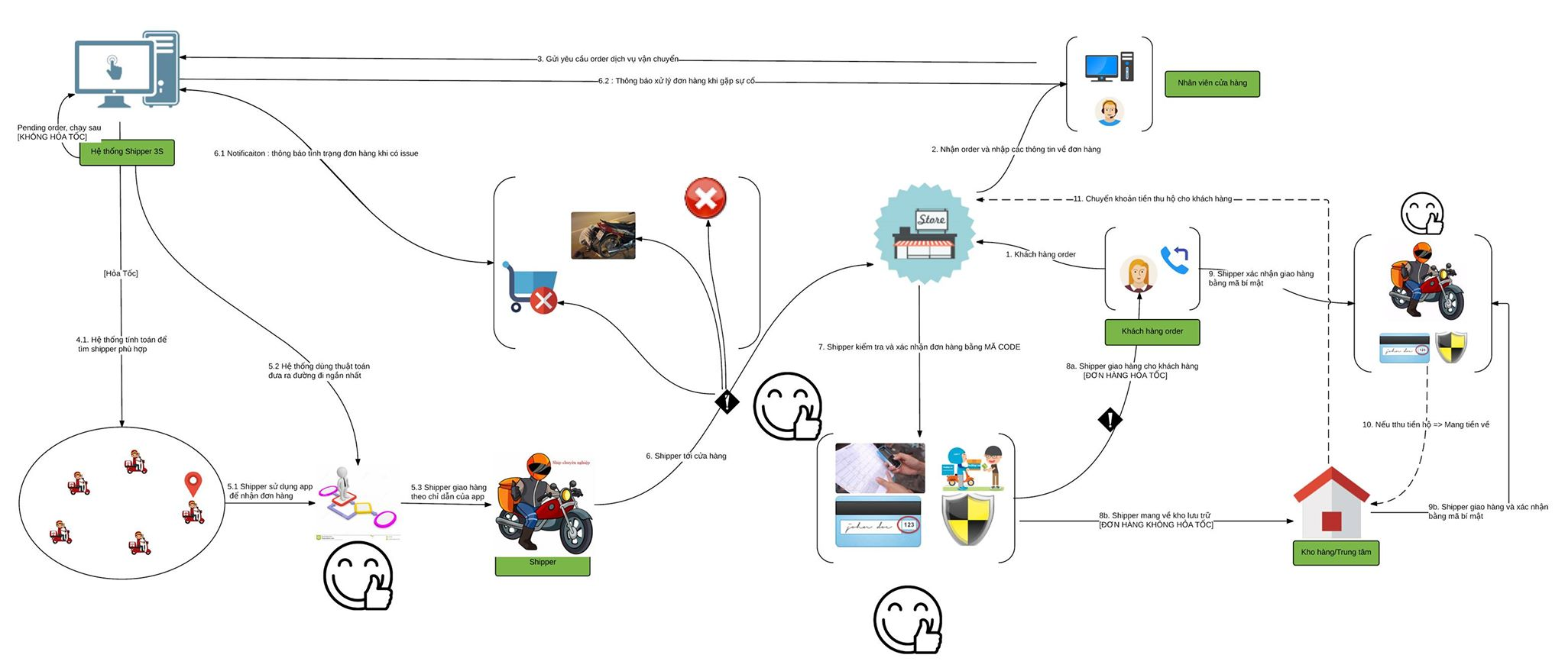
3.1. Business Process -ビジネスプロセ
Actor:
Business rich picture of system

Slide 24



3.1. Business Process -ビジネスプロセ
Actor:
Admin
Shipper
Store

Slide 25
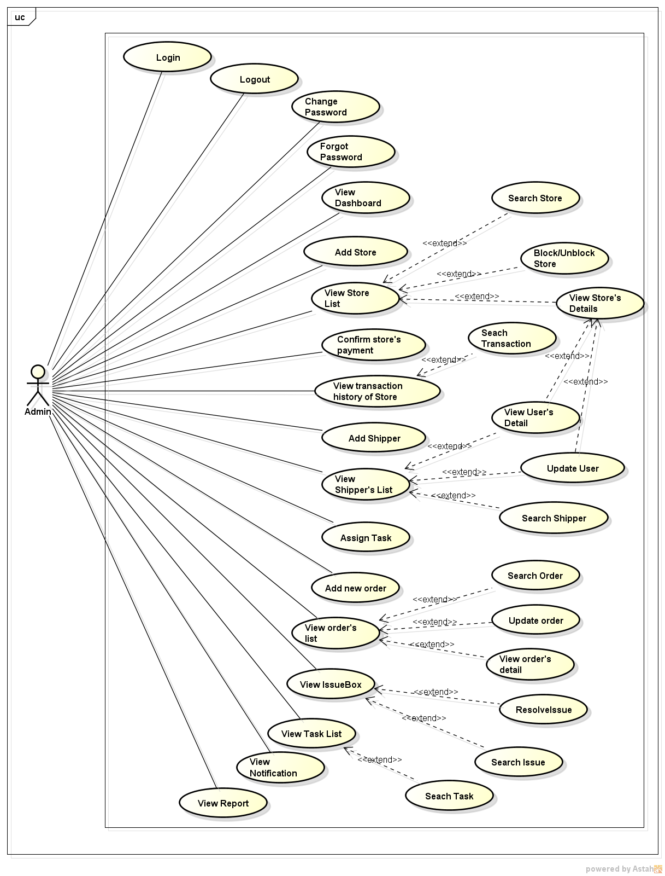
3.2. Functional Requirements - 機能要求
User use case diagram for Admin

Slide 26
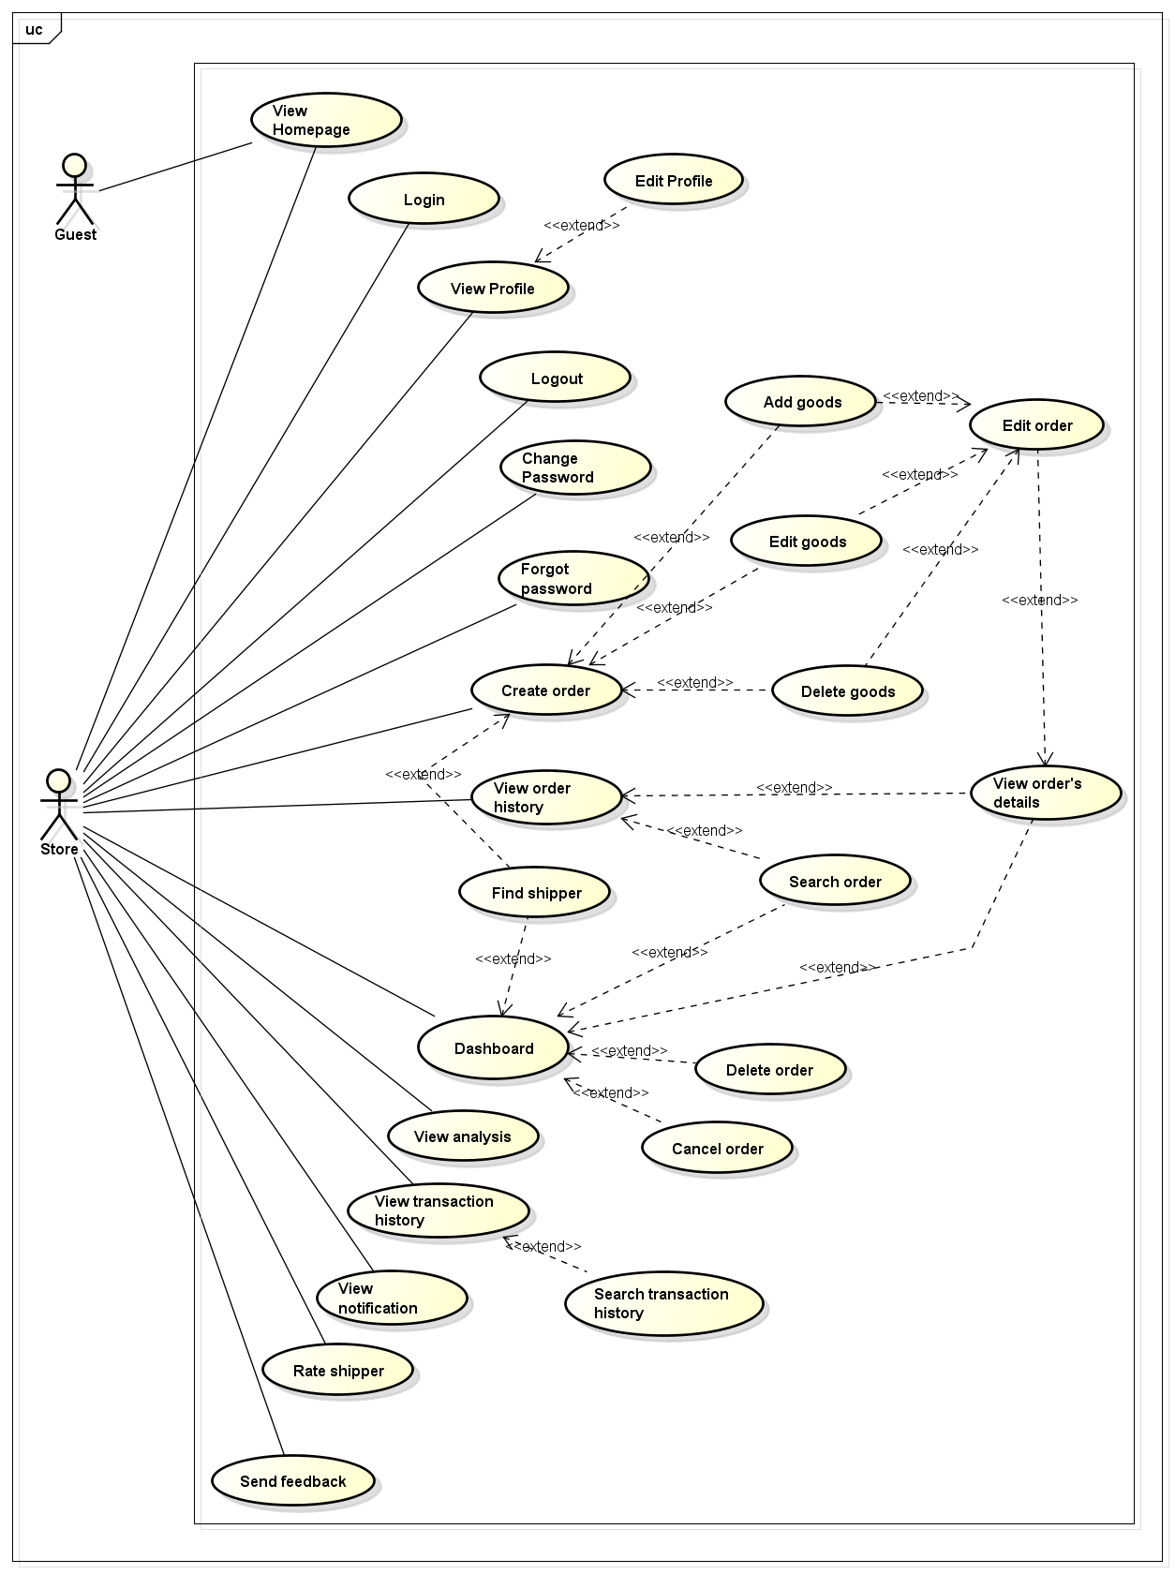
3.2. Functional Requirements - 機能要求
User use case diagram for Store

Slide 27
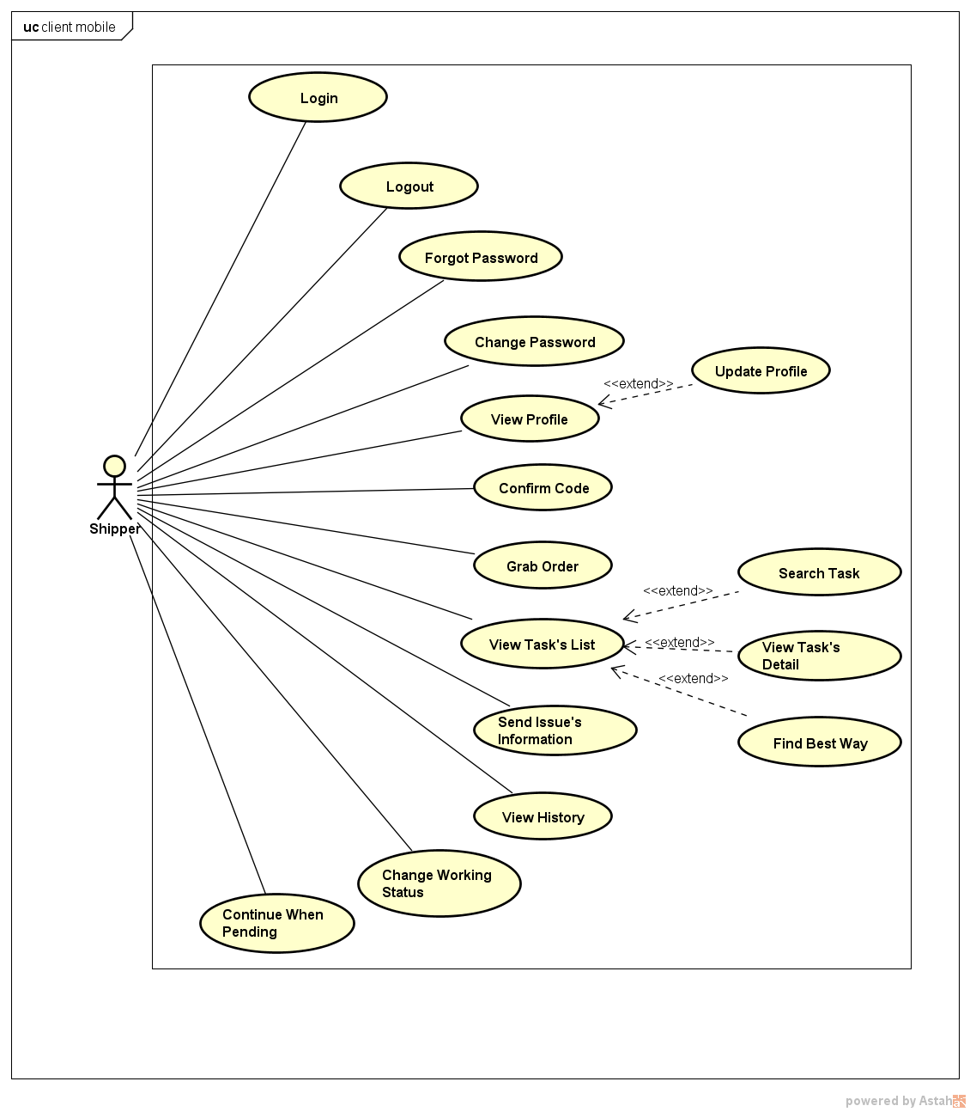
3.2. Functional Requirements - 機能要求
User use case diagram for Shipper

Slide 28
3.3. Non - Functional Requirements - 機能要求
Usability
- User interface should be clear and easy to use.
- User can complete each function in less than 10 actions
Performance
- System could support a large number of users at the same time.
Other functions of system perform normal while have many order running on application
Maintainability
Application is easily to maintain without any crashes

Slide 29
3.3. Non - Functional Requirements - 機能要求
Scalability
The system is easy to extend and add new feature.
Availability
The application is available 24/7.
Security
- Information of user on server is secured.
- With store, order is ensured that execute exactly and in time.

Slide 30
4. Software Design (ソフトウェア設計)
4.1.Architectural Representation
アーキテクチャ表現
4.2. Technology and Reason
テクノロジーと理由
4.3. Database Design
データベース設計
4.4. Class Diagram
クラス図
4.5. Sequence Diagram
シーケンス図
4.6. Screen Design
画面の設計

Slide 31
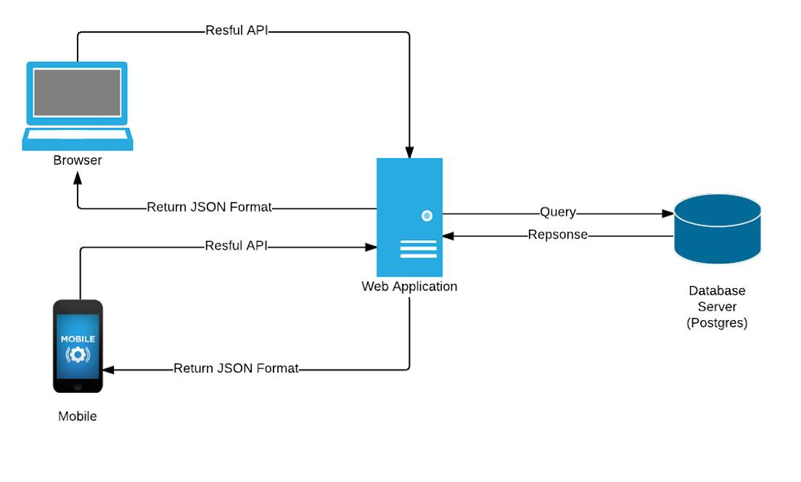




4.1. Architectural Representation - アーキテクチャ表現
Overview of Karywell system

Slide 32
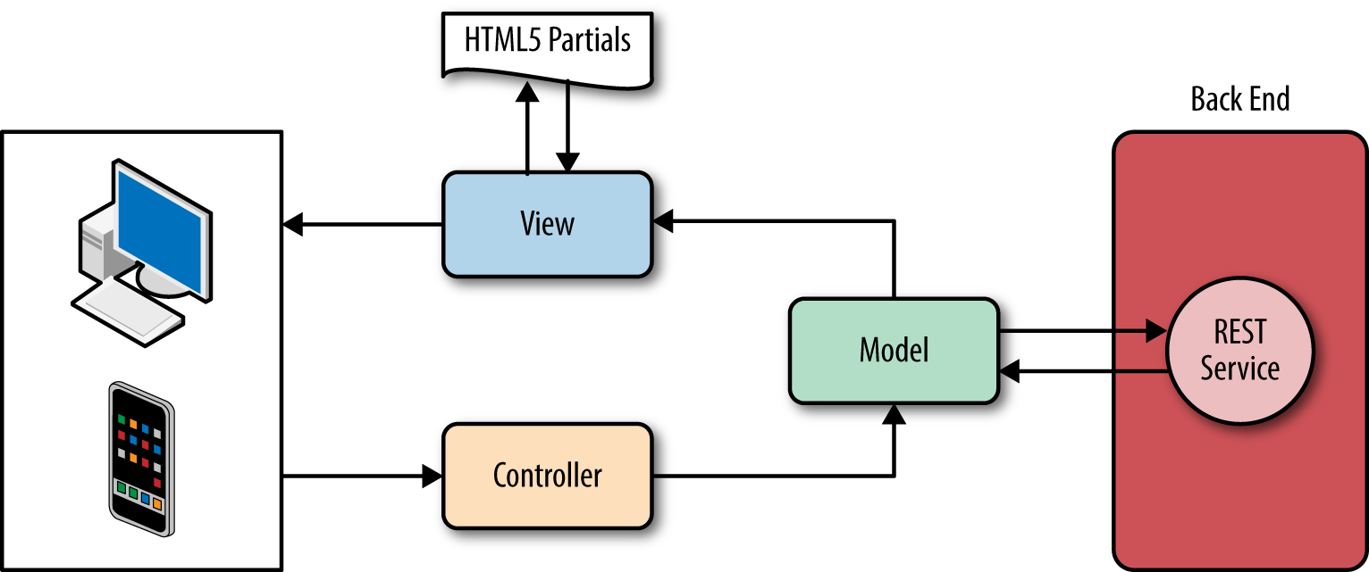
4.2. Technology and Reason -テクノロジーと理由
Mobile application
Because we want to create an application that build once but run on many platform mobile (IOS, Android...). Therefore we choose the IONIC framework to create a hybrid application. This framework uses Angular which allows us easy to develop application following MVC model.

Slide 33
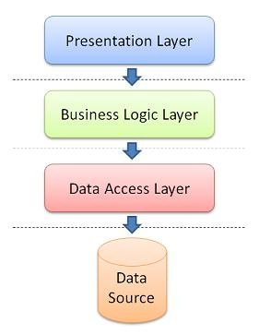
4.2. Technology and Reason -テクノロジーと理由
Web application : N-layers model
The benefits of N-layer model:
Other applications will be able to reuse the functionality exposed by layers
The maintenance of application is easier because of the low coupling between layers.
It's easy to distribute layers over multiple physical tiers. This can make a very good impact on application by improving performance (sometimes), scalability and fault tolerance.
Layers make your application more testable.

Slide 34
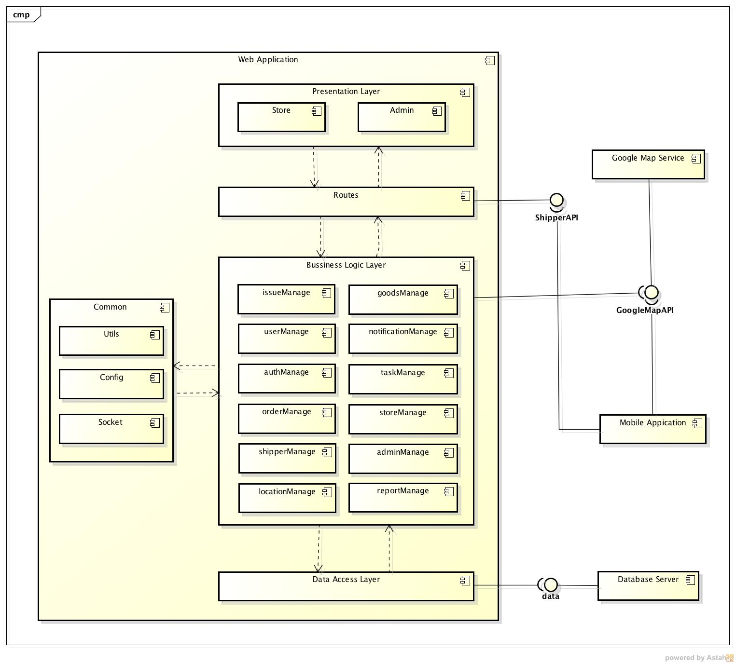
4.2. Architectural Representation - アーキテクチャ表現
Component Diagram

Slide 35
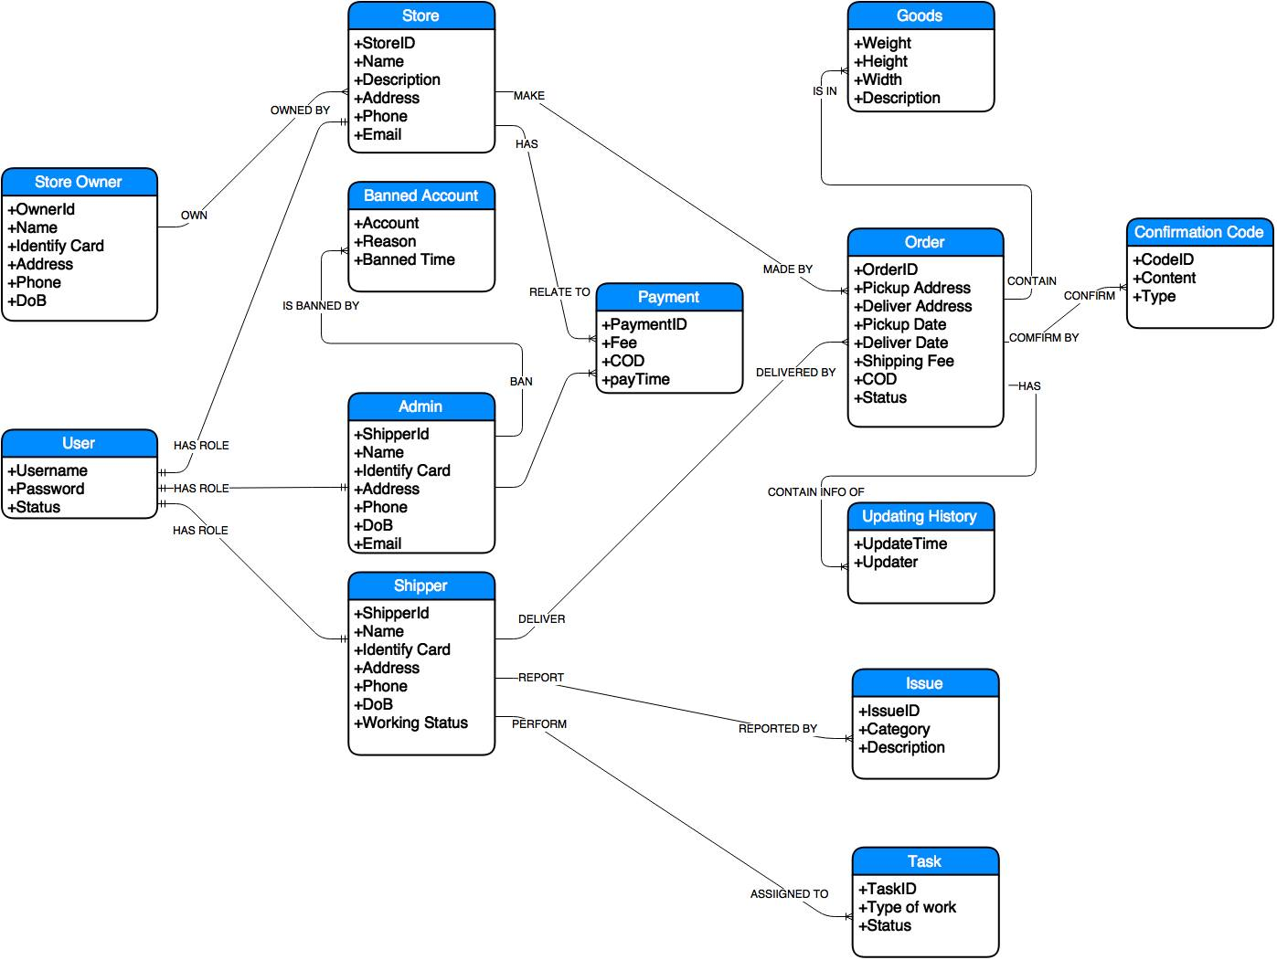
4.3. Database Design - データベース設計
Entity Relationship Diagram

Slide 36
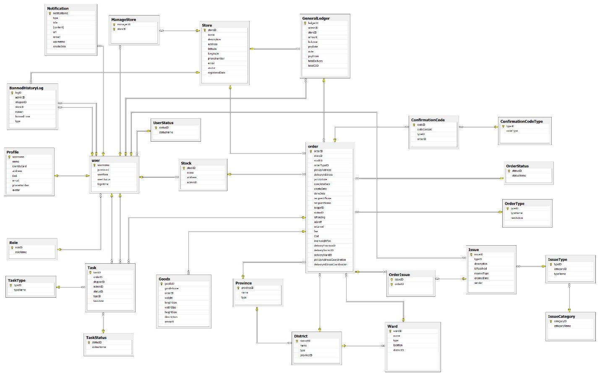
4.3. Database Design - データベース設計
Entity Relationship Diagram

Slide 37
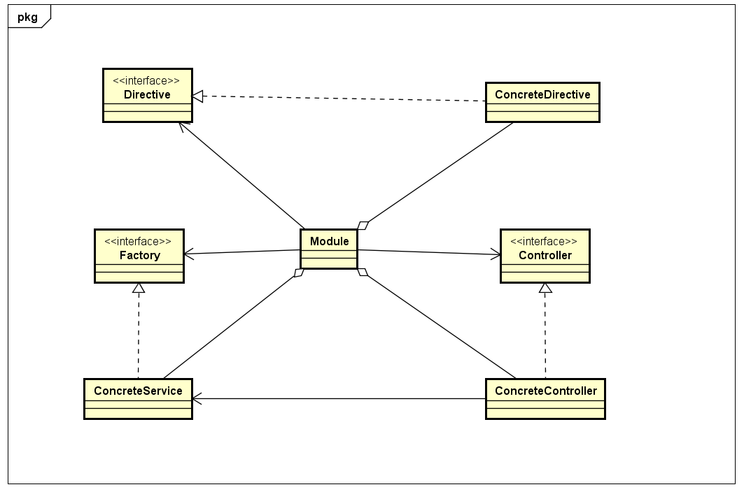
4.4. Class Diagram - クラス図
Class Diagram of Angular Module

Slide 38
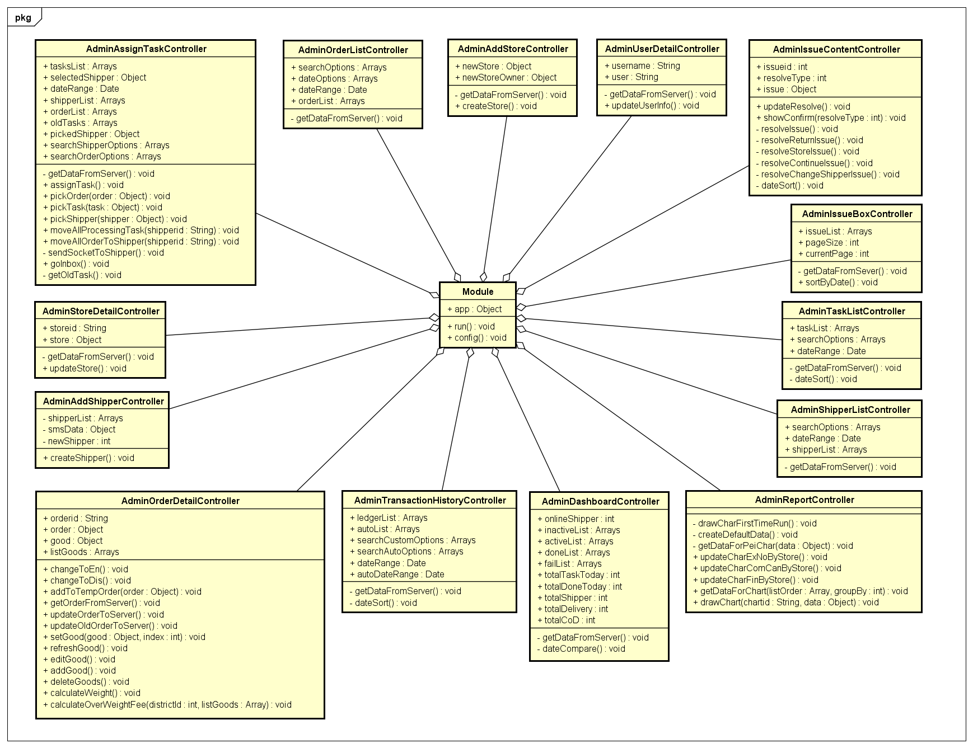
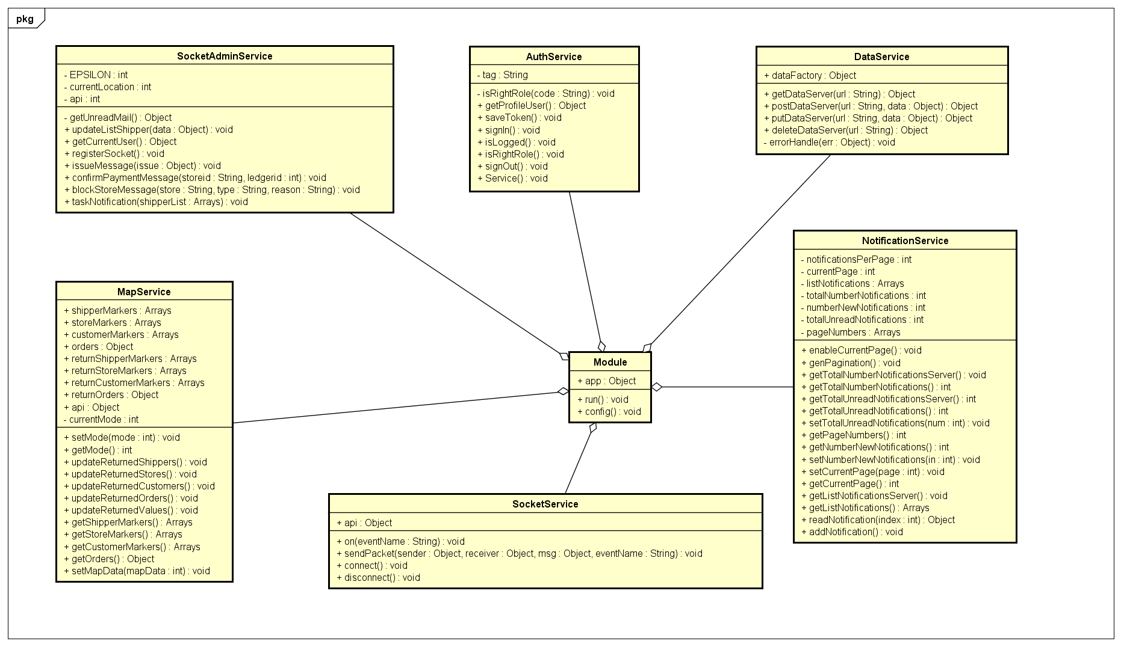
4.4. Class Diagram - クラス図
Class Diagram of Controller for Admin
Class Diagram of Service for Admin

Slide 39
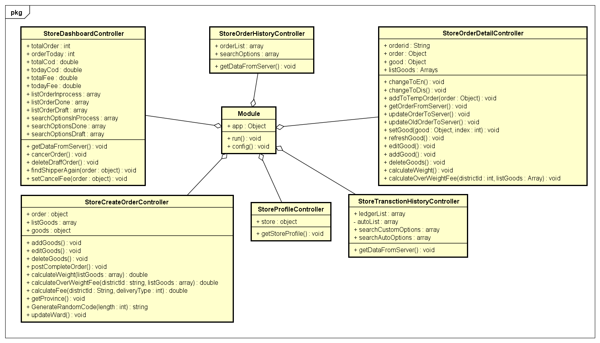
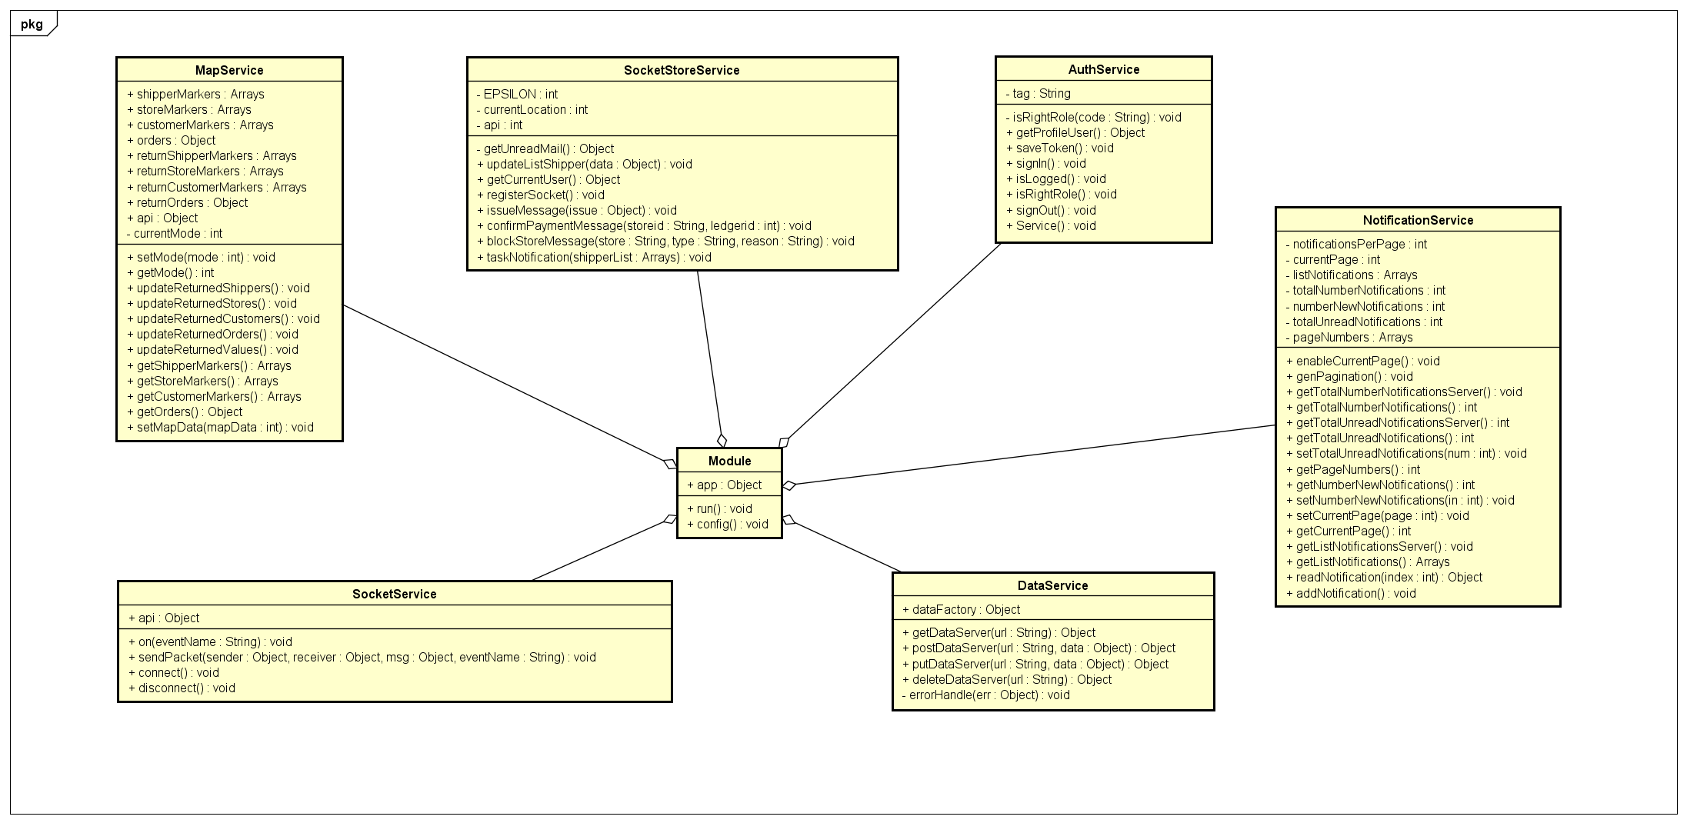
4.4. Class Diagram - クラス図
Class Diagram of Controller for Store
Class Diagram of Service for Store

Slide 40
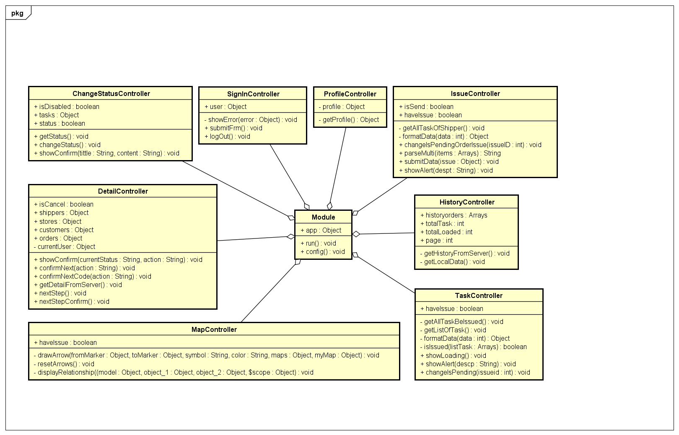
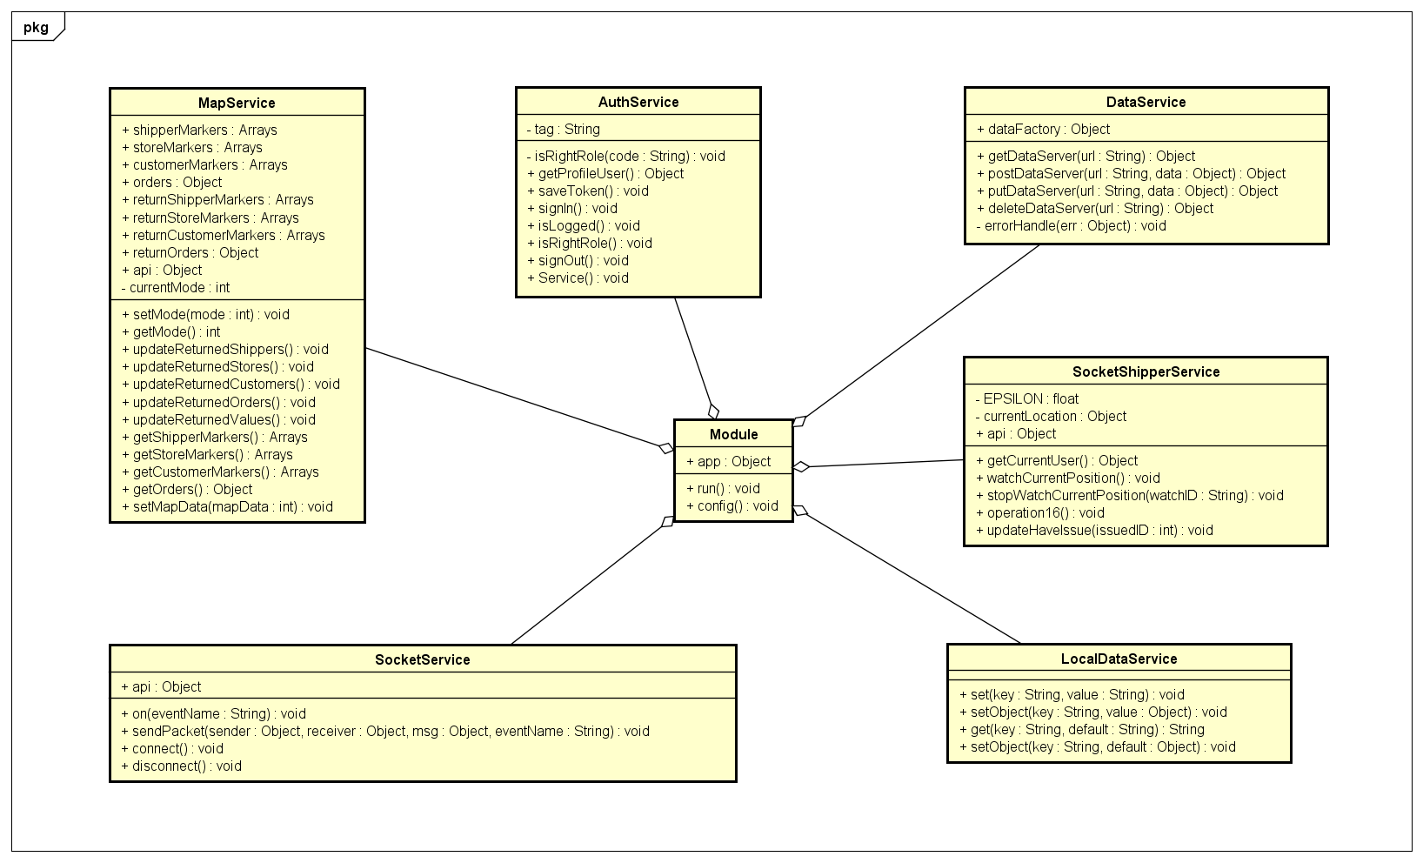
4.5. Class Diagram - クラス図
Class Diagram of Controller for Shipper
Class Diagram of Service for Shipper

Slide 41
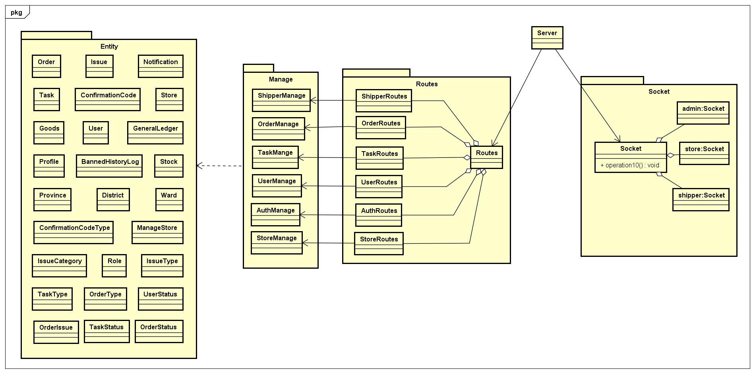
4.4. Class Diagram - クラス図
Class Diagram of Server

Slide 42
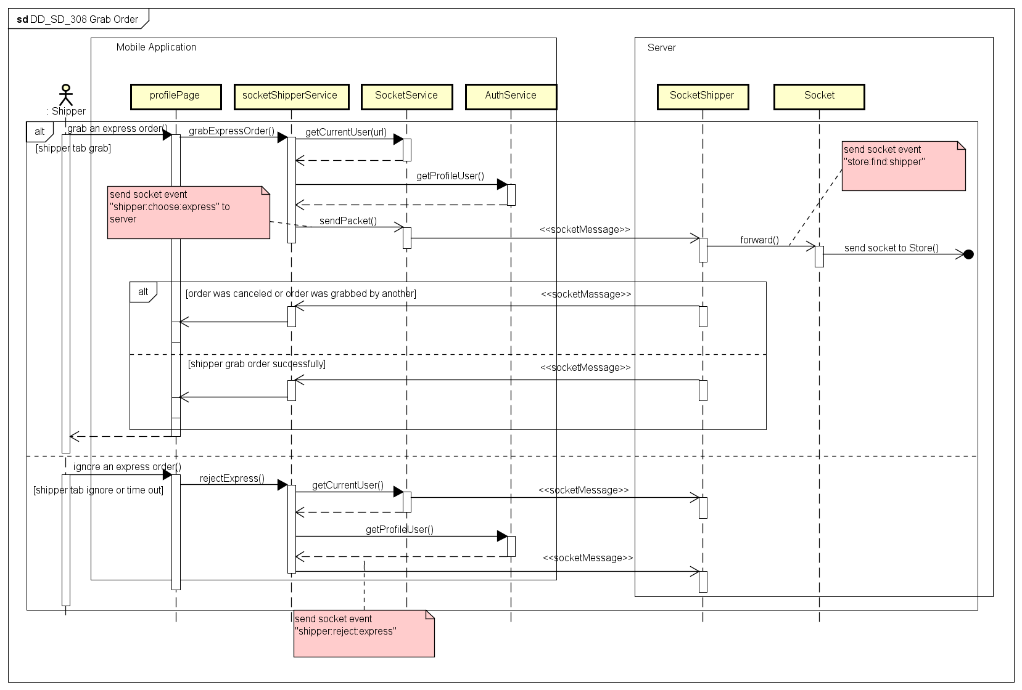
4.5. Sequence Diagram - シーケンス図
Sequence Diagram of Grab Order use case

Slide 43
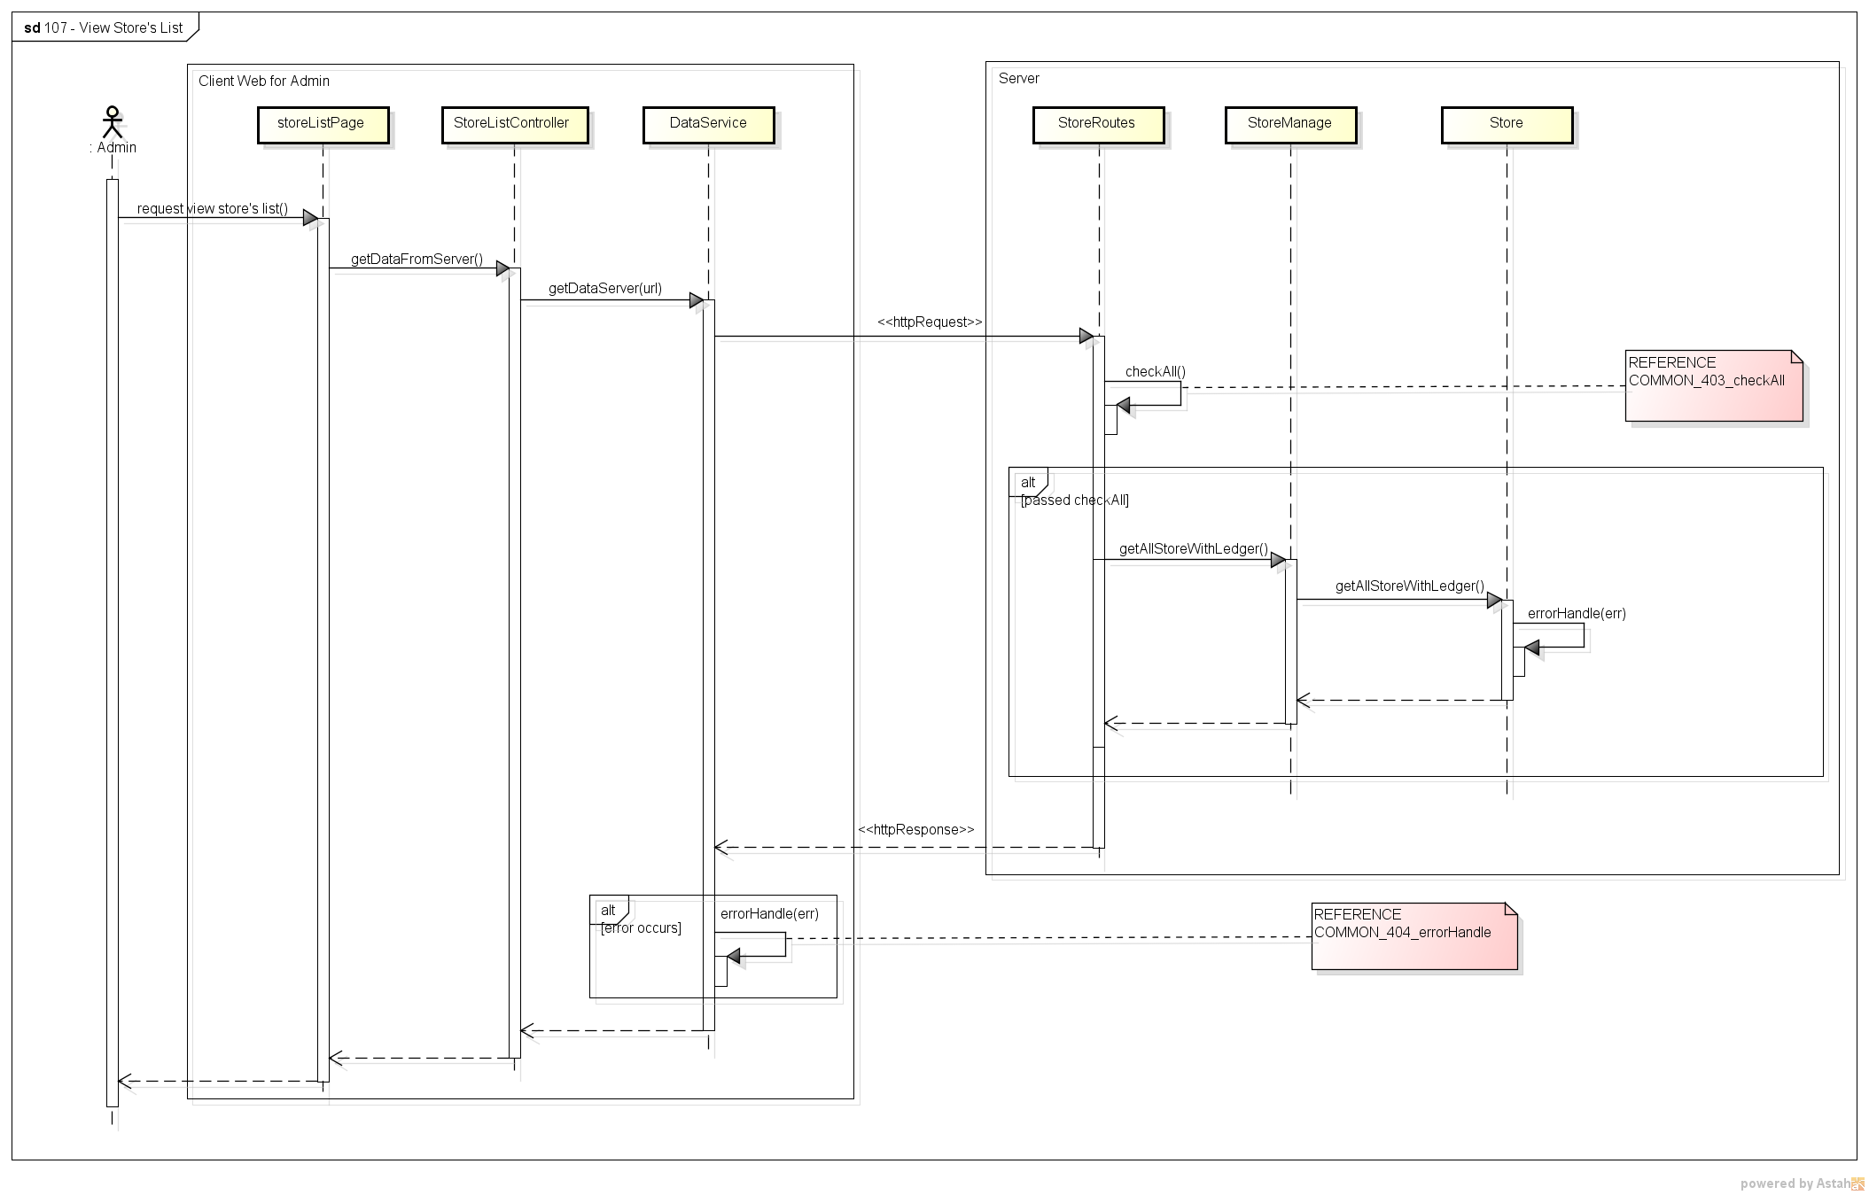
4.5. Sequence Diagram - シーケンス図
Sequence Diagram of View Store’s List use case

Slide 44
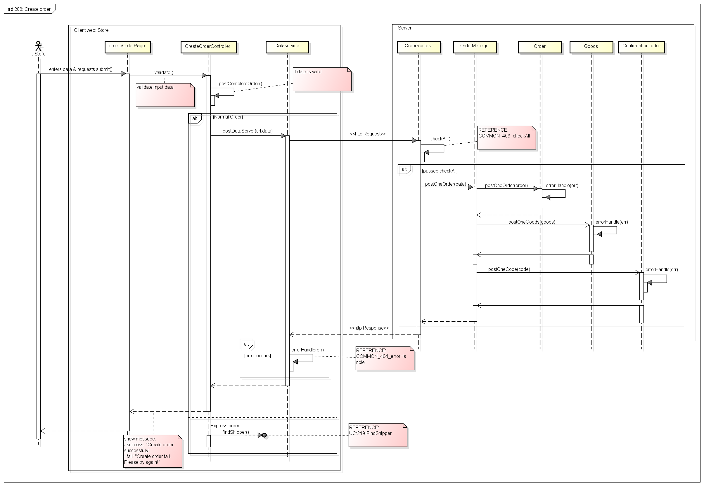
4.5. Sequence Diagram - シーケンス図
Sequence Diagram of Create Order use case

Slide 45
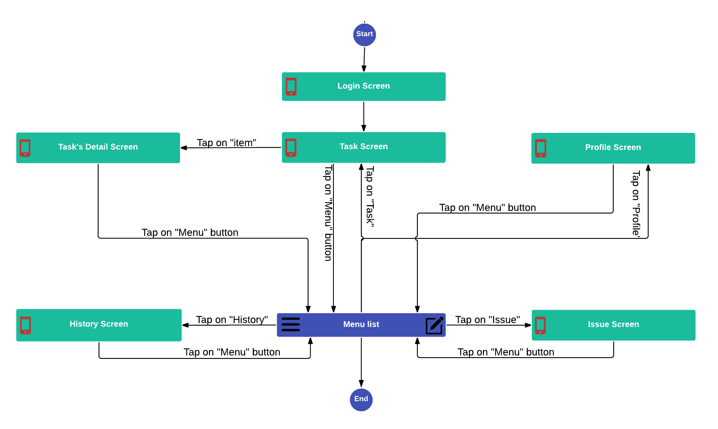
4.6. Screen Design- 画面の設計
4.6.1. Screen Flow - 画面の流れ
Mobile Screen Flow

Slide 46
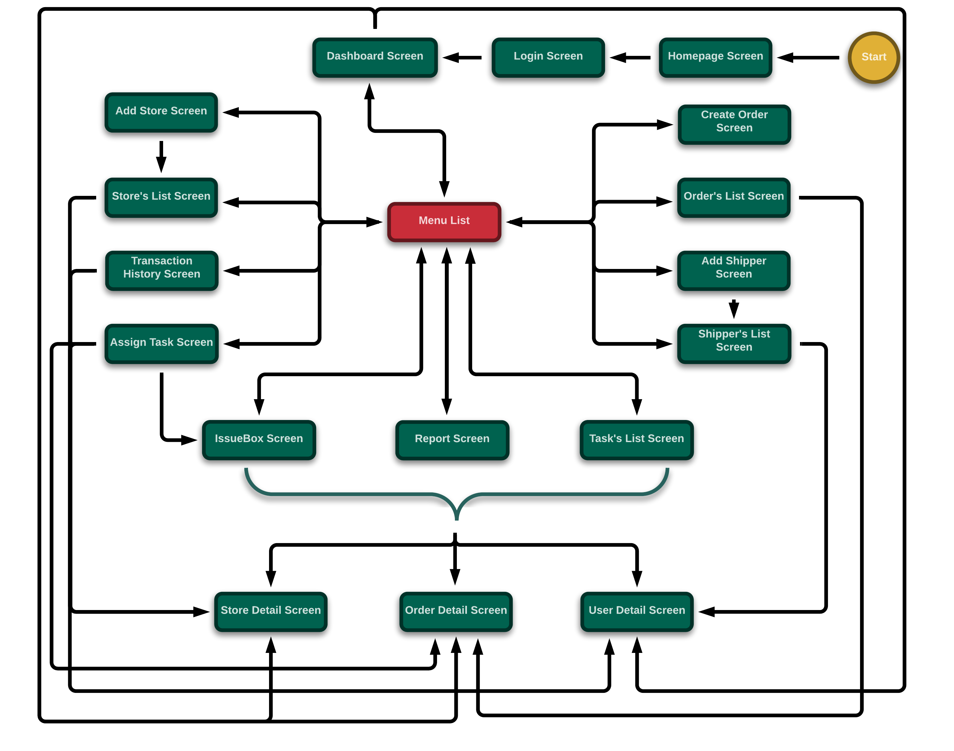
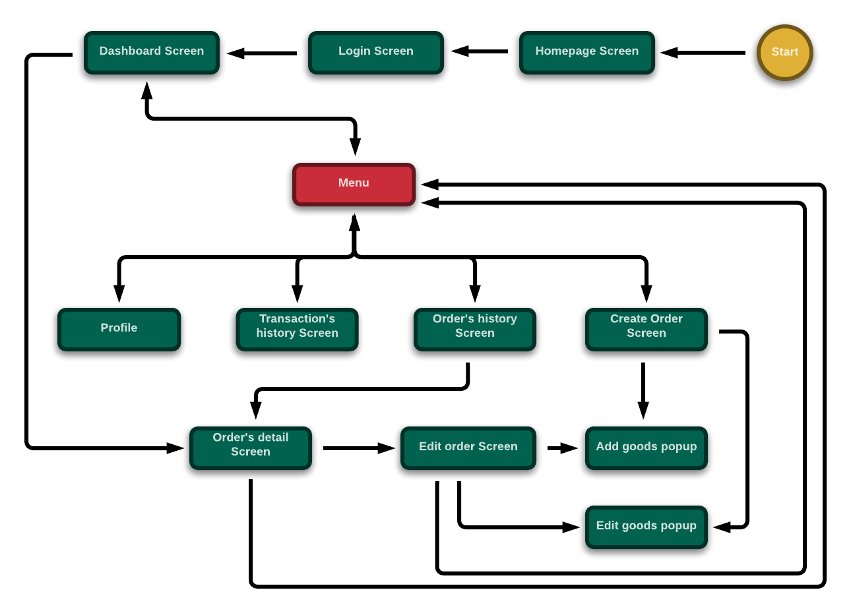
4.6. Screen Design- 画面の設計
4.6.1. Screen Flow - 画面の流れ
Client-web for Admin Screen Flow
Client-web for Admin Screen Flow

Slide 47
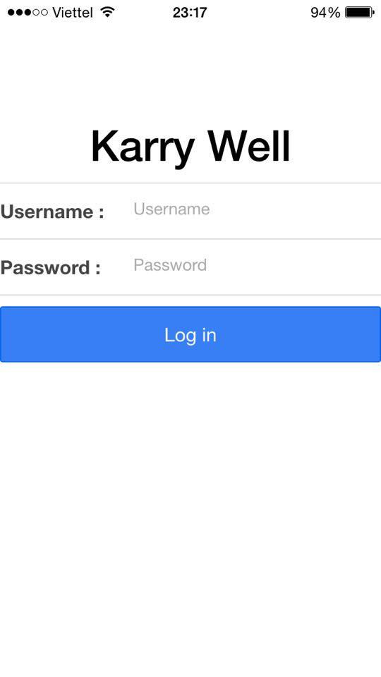
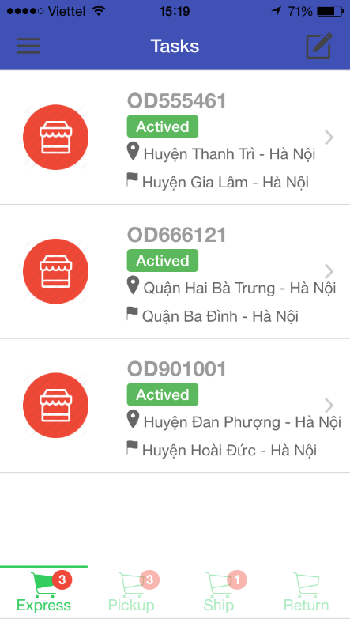
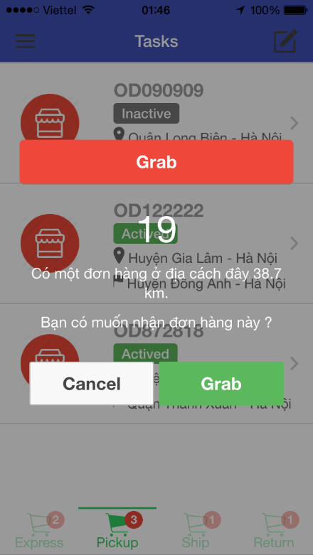
4.6. Screen Design- 画面の設計
4.6.2. Screen Design - 画面の設計
Screen of Mobile Application

Slide 48
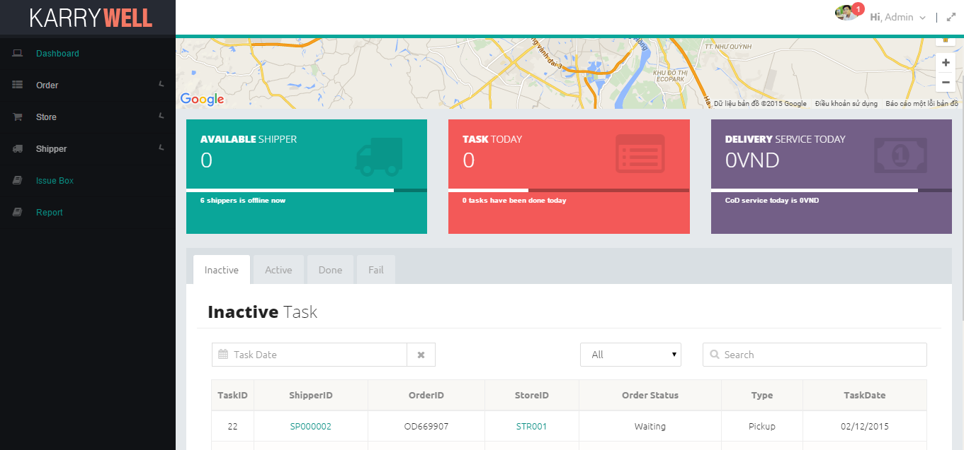
4.6. Screen Design- 画面の設計
4.6.2. Screen Design - 画面の設計
Screen of Client-Web for Admin

Slide 49
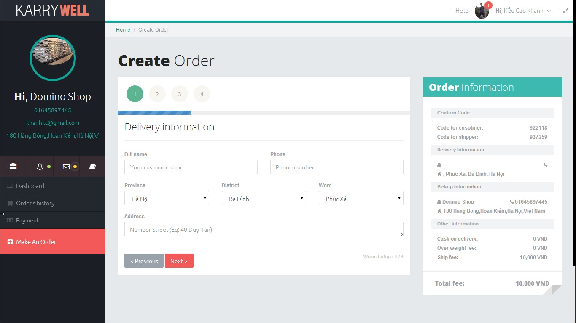
4.6. Screen Design- 画面の設計
4.6.2. Screen Design - 画面の設計
Screen of Client-Web for Store

Slide 50
5. Quality Control (品質管理)

Slide 51
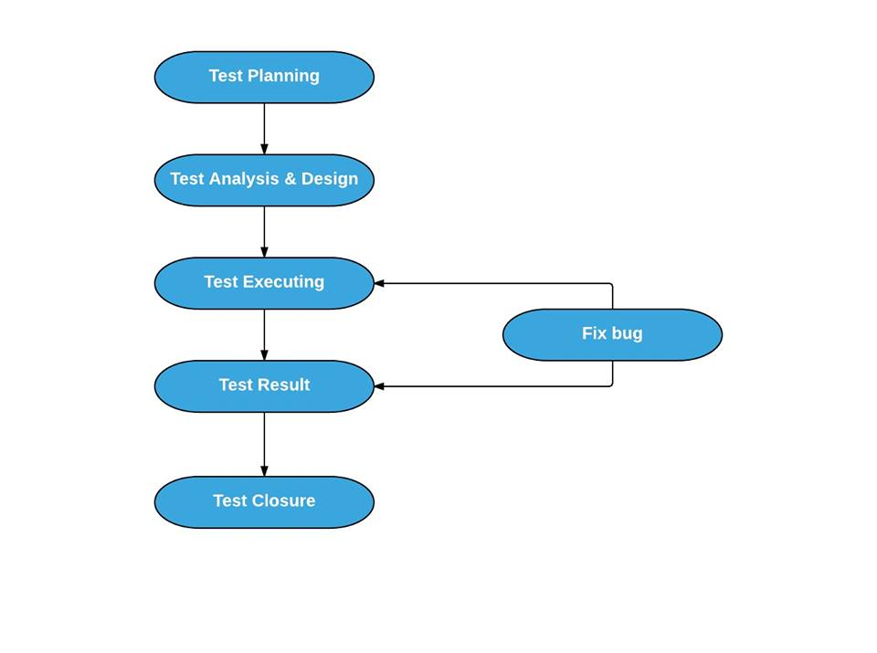
Testing Process
Notes:
1.Base on Project Plan, Project Schedule , SRS to create test plan:
Features to be tested
Acceptance Test Criteria
Environment
Schedules
Responsibilities
Risks and contingencies
…
Ở bước này , em thiết kế các testcase từ các yêu cầu liên quan như là usecase
Executing theo từng testcase
Khi test có lỗi, em sẽ tạo các báo cáo lỗi trong suốt quá tình test và theo dõi chúng cho đến khi chúng được xử lí => Những lỗi đã được developer chỉnh sửa ,sẽ được test lại
Cuối cùng, em tạo báo cáo lỗi final, tạo bảng tổng kết đánh giá hoạt động kiểm lỗi ,xác định xem đã đạt tiêu chí thnahf công chưa

Slide 52
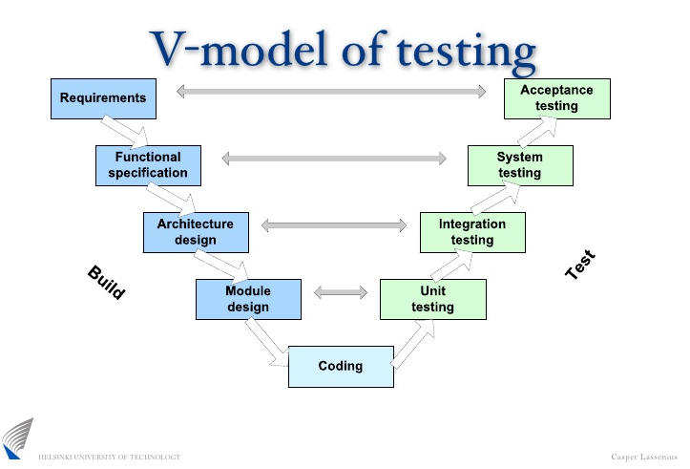
Testing Model
Notes:
Dựa vào requiment cùa dự án,dự án của team có kích thước trung bình,và các yêu cầu dự án là rõ ràng, cố định nên nhóm em chọn V model để thực hiện quá trình test.Khi thực hiện theo V-model thì các hoạt động kiểm thử được tiến hành song song ngay từ đầu chu trình cùng với các hoạt động phát triển nên
Tiết kiệm được thời gian, Chủ động trong việc phát hiện bug, sớm tìm ra bug ngay từ những bước đầu.

Slide 53
Testing Types
User Interface Testing
Regression Testing
Performance Testing
Function Testing

Slide 54






Testing Tools & Environment
Software:
Google Chrome, Firefox: Used to test size of web page and size of components on page.
Microsoft Excel: Log bug.
Hardwares :
Windows 7 Professional 64-bit
Iphone 5 iOS version 7.1.1
Android Google Nexus 5 Android version 6.0

Slide 55
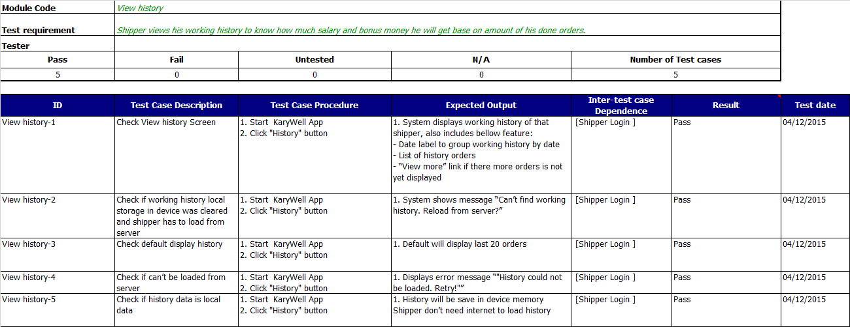
Test Case Example
59
Use Case

Slide 56
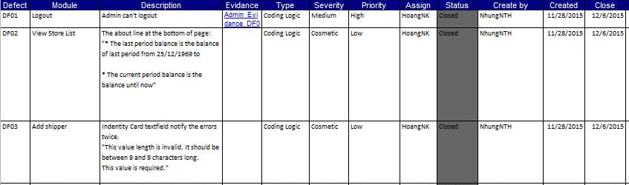
Log bug Example
59
Use Case
Notes:
While executing test, tester detect, log bug and assign to appropriate developer.

Slide 57

Bug Run Chart
59
Use Case

Slide 58

Test Report Phase 1
59
Use Case
Notes:
Tester has responsibility to write test report for each test phase. Finish testing phase, Test leader create Test report

Slide 59

Test Report Final
59
Use Case

Slide 60
6. Project Result (プロジェクト結果)
Project Summary
Out of scope:
Combine order function
Online payment function
Auto due with issue
Chat between store and admin function
Auto reconnect after disconnect because of error.
Lesson Learn:
Apply all knowledge and skills that we have studied
Improve skills: teamwork, document writing, project management, communication, planning, resolving conflict.
Technical: AngularJS, NodeJS, Ionic Framework, PostgreSQL
Future Work:
Develop more functions: pay fee via banking service, stock management, API for store,…
Improve infrastructure and quality of product

Slide 61
7. Demo (デモ)

Slide 62
8. Q & A (質問と回答)

